Slide 1
TIME MANAGEMENT

Slide 2
“Time management” is the process of organizing and planning how to divide your time between specific activities. Good time management enables you to work smarter – not harder – so that you get more done in less time, even when time is tight and pressures are high. Failing to manage your time damages your effectiveness and causes stress.

Slide 3
It seems that there is never enough time in the day. But, since we all get the same 24 hours, why is it that some people achieve so much more with their time than others?
The answer lies in good time management.

Slide 4
Good time management requires an important shift in focus from activities to results: being busy isn’t the same as being effective.
Spending your day in a frenzy of activity often achieves less, because you’re dividing your attention between so many different tasks. Good time management lets you work smarter – not harder – so you get more done in less time.

Slide 5
“Time management” refers to the way that you organize and plan how long you spend on specific activities.
Greater productivity and efficiency.
A better professional reputation.
Less stress.
Increased opportunities for advancement.
Greater opportunities to achieve important life and career goals.

Slide 6
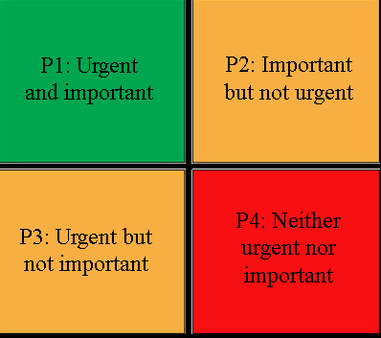

Slide 7
Priority 1: Urgent and important (U and I) Priority 3: Urgent but not important (U not I) (Delegate) | Priority 2: Important but not urgent (I not U) Priority 4: Neither urgent nor important (neither U nor I) (Delegate)

Slide 8
These tasks have to be prioritised over everything. You are ultimately responsible and therefore have to ensure that the tasks are carried out effectively and on time These tasks require an urgent response but they are not important to your role. Because these are not important, you should avoid putting too much time into these tasks. response, it is better to delegate them to someone else | These tasks are not priorities, but you would usually want to do them yourself because they are important. Because they are important it is a good idea not to leave them too late, otherwise they will become a priority 1 task. You should ask yourself whether you need to do these tasks at all. Such tasks are distractions and are not a good use of your time, so delegate where appropriate.

